Slide 1



Massive data contributions from the National Land Survey of Finland to the OpenStreetMap Database
Internship work overview
Alexys Ren
May – August 2023

Slide 2
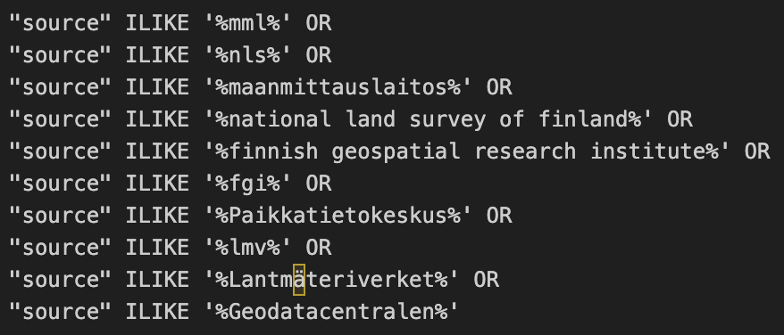
Identifying NLS-related data among other OSM data

Slide 3
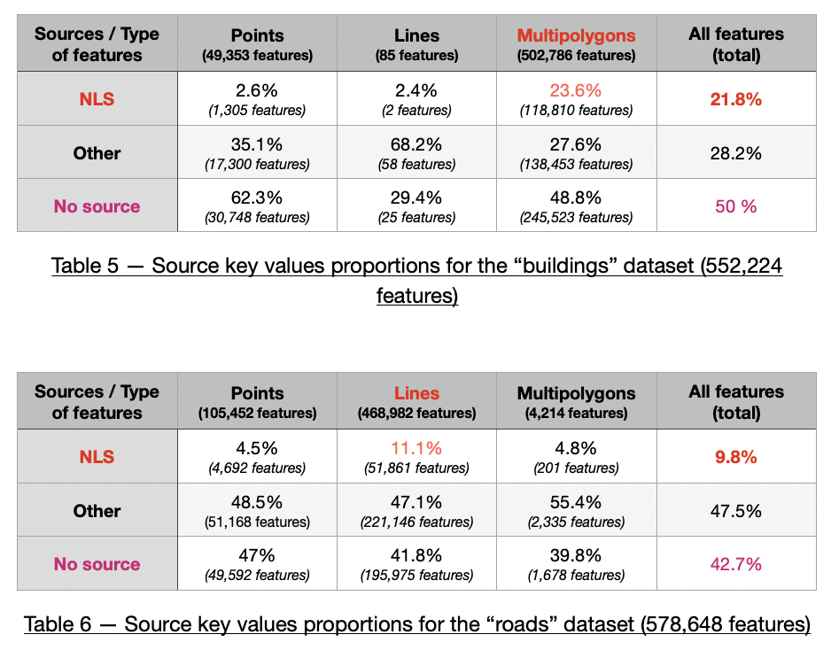
NLS-related data proportions

Slide 4
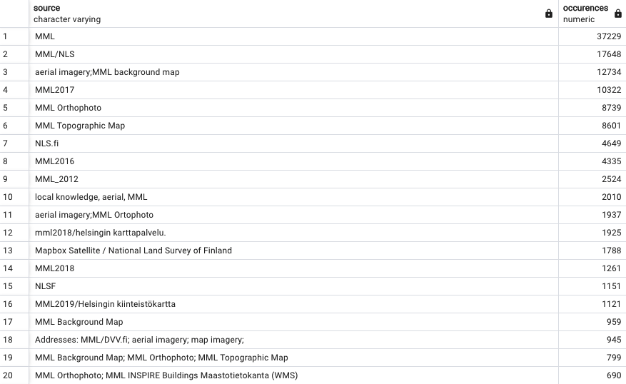
Source tag spelling on NLS-related buildings

Slide 5
NLS massive data contributions

Slide 6
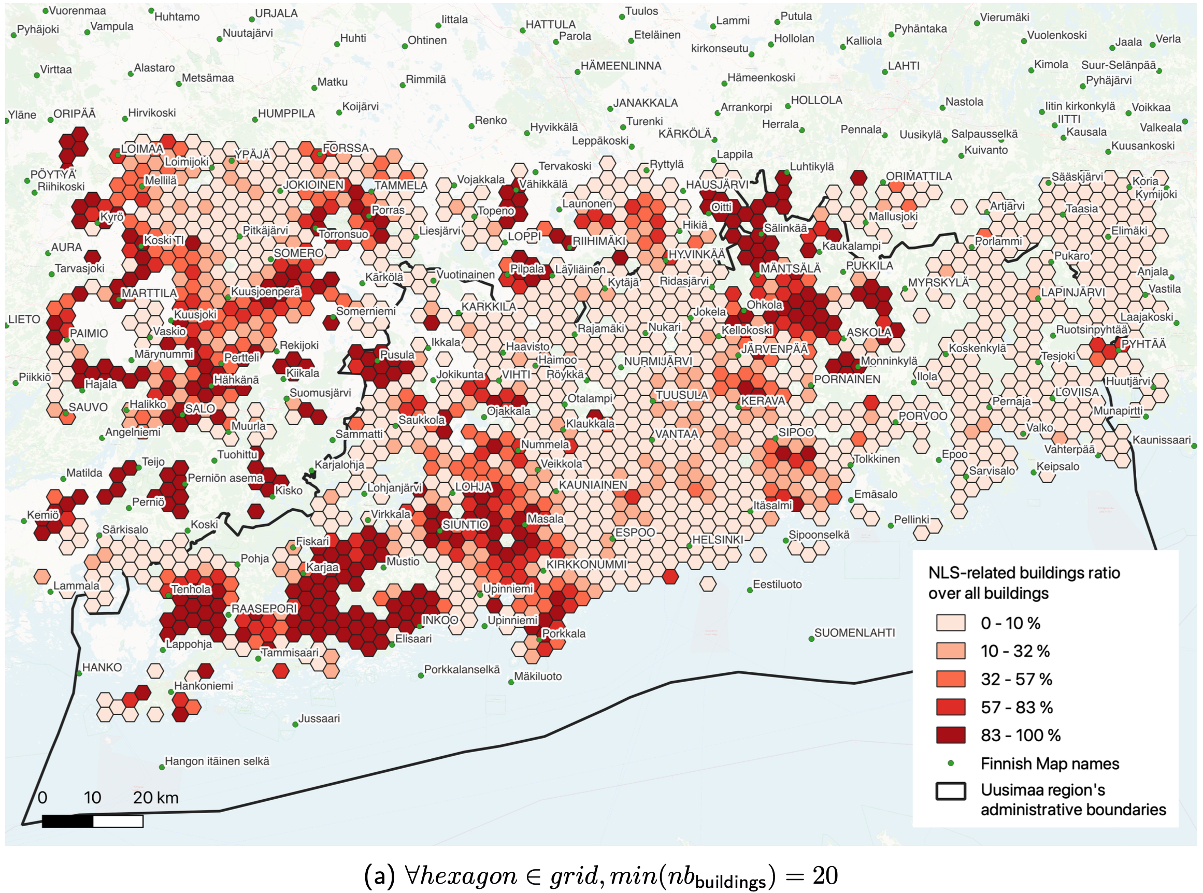

Slide 7
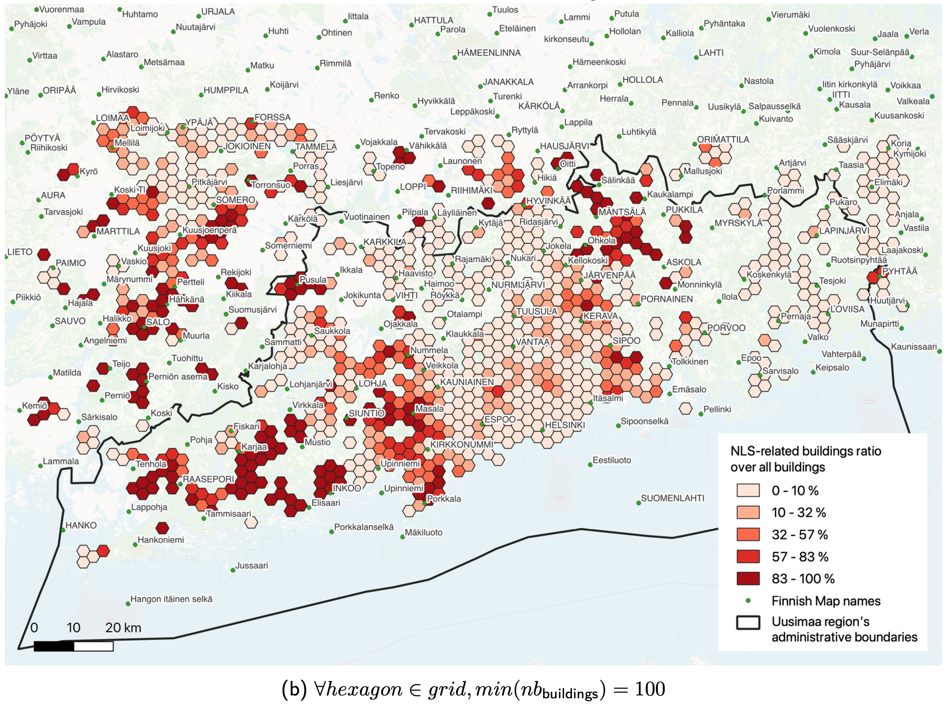

Slide 8
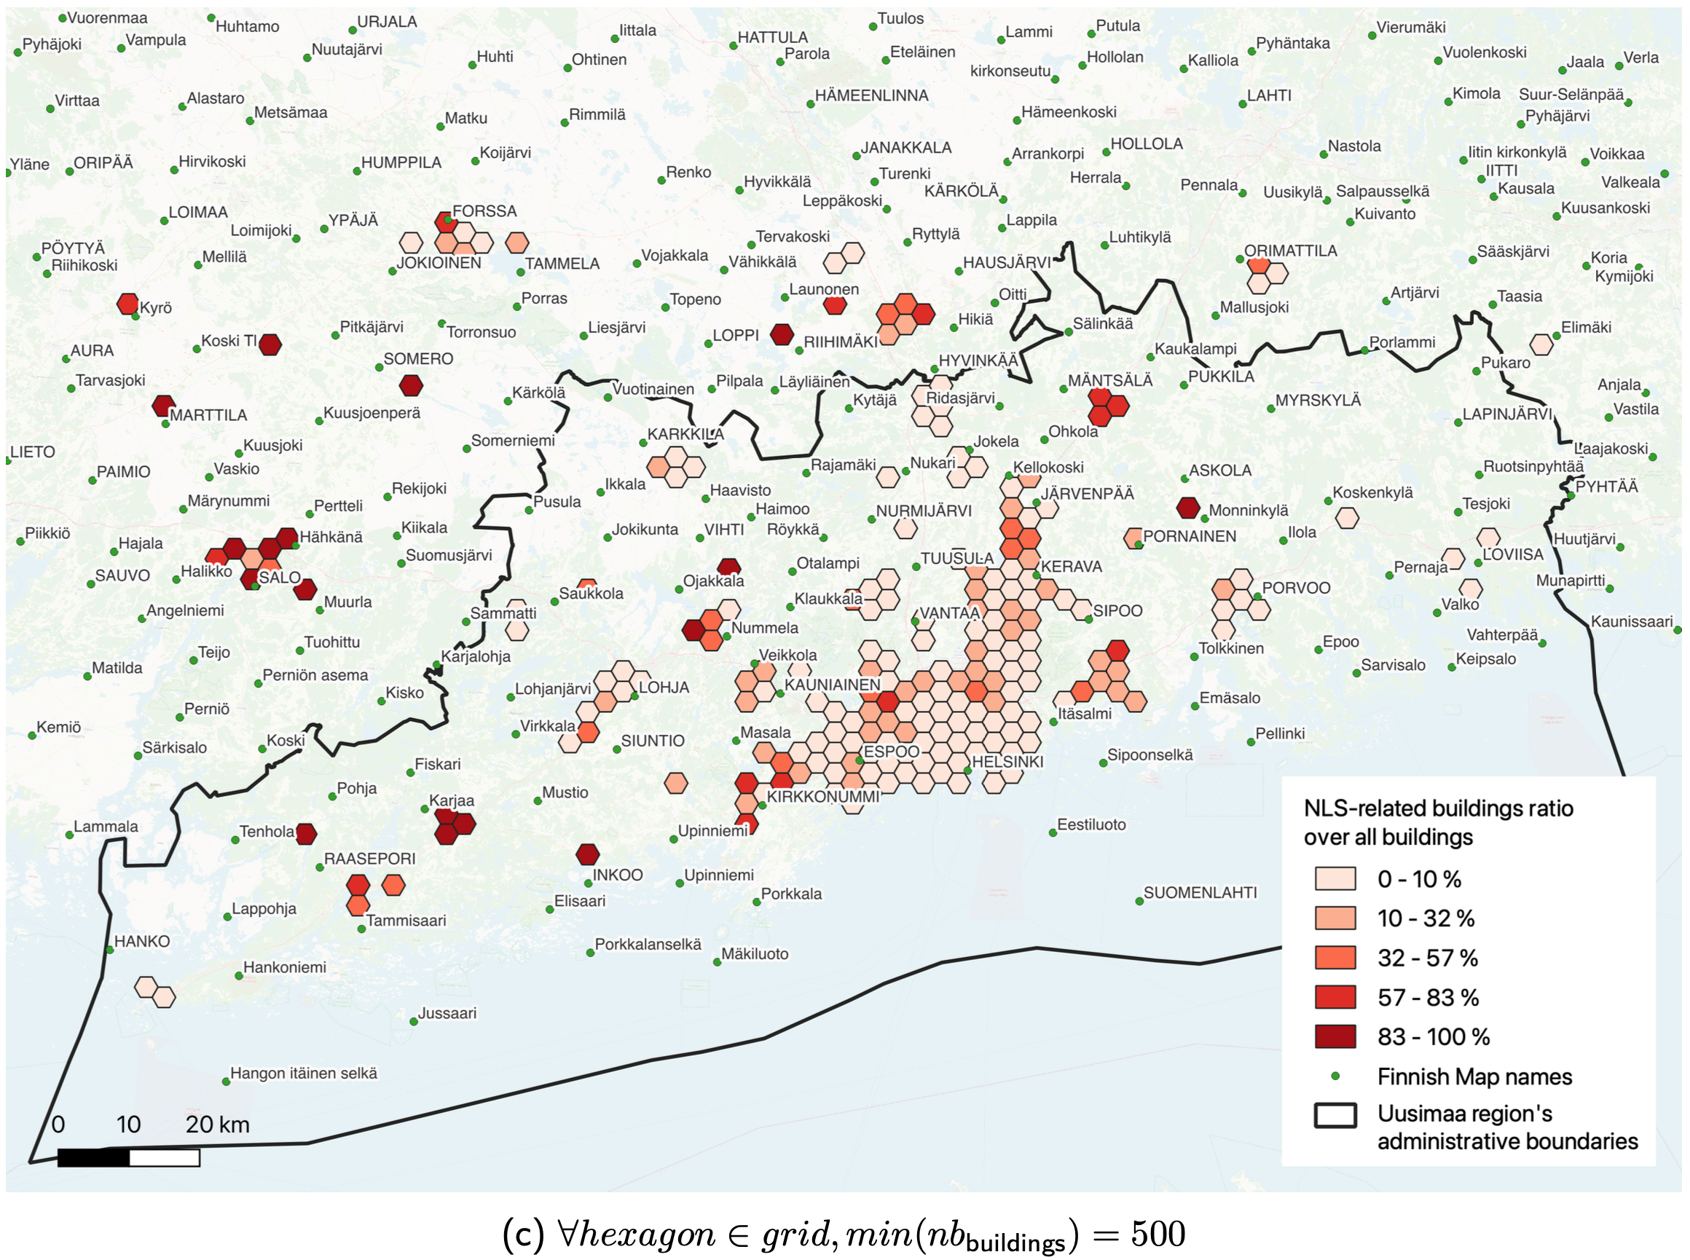

Slide 9
Geometry-level modified NLS buildings

Slide 10
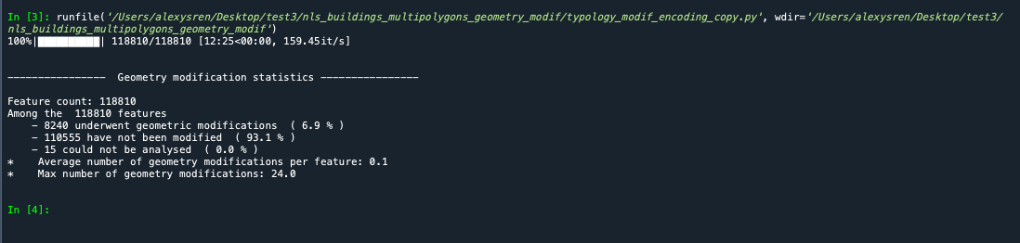
Geometry-level modified NLS buildings

Slide 11
